Slide 1
Chapter 11
System-on-a-chip
A case study

Slide 2
Chapter outline
FPGA devices
CAD tools
Altera FPGA devices and tools as examples
Design example – system-on-chip alarm clock

Slide 3
FPGA devices
Field Programmable Gate Array (FPGA) devices contain a large number of logic elements and versatile wiring resources that can be used to interconnect them.
FPGAs also contain some on-chip memory blocks, which can be used to store programs and data.
FPGAs have many I/O pins that can be used to connect to external devices and transducers.
FPGAs can be used to implement entire systems on a single chip.

Slide 4
FPGA support for embedded systems
Processor core that can be instantiated on the FPGA chip
Memory modules and interfaces
I/O interfaces
Timer/counter circuits
CAD software tools for designing and implementing a system

Slide 5
CAD tools
Altera CAD tools are called Quartus II software.
Quartus II comprises a range of tools that can be used to design and implement a digital system in an FPGA device.
One of the tools is the SOPC Builder, which can be used to design systems that include a processor core and a variety of other parameterized modules.

Slide 6
Nios II processor
Nios II processor is presented in Appendix B.
It is provided in 3 versions: economy, standard and fast.
We will use the standard version, which includes an instruction cache but has no data cache.
The processor is specified as a module written in a hardware description language.

Slide 7
Parallel I/O Interface - PIO
PIO is a parameterized module that can be used for both input and output purposes. It can be configured at design time as:
an input port
an output port
a bidirectional port

Slide 8
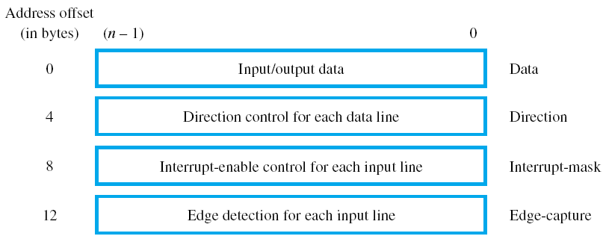
Registers in the PIO interface

Slide 9
Interval Timer
Includes a counter whose contents are decremented by one in each clock cycle
It can raise an interrupt request when the contents of the counter reach zero
It can be programmed for continuous operation, where the counter is reset to its starting value each time its contents are decremented to zero

Slide 10
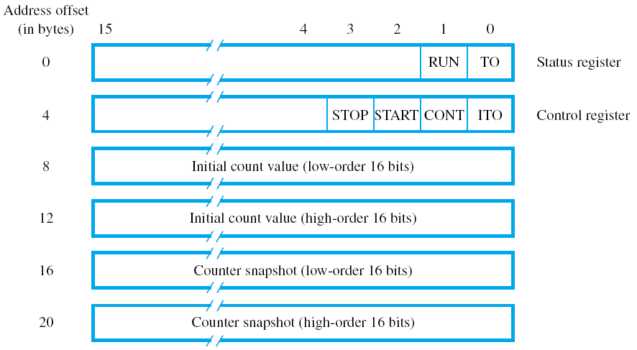
Registers in the Interval Timer interface

Slide 11
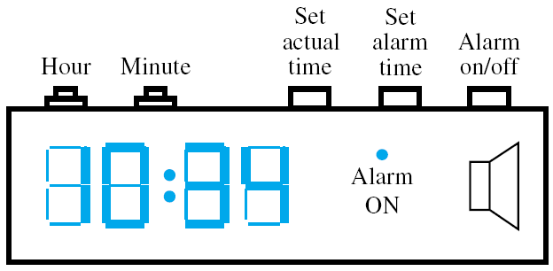
User’s view of the alarm clock

Slide 12
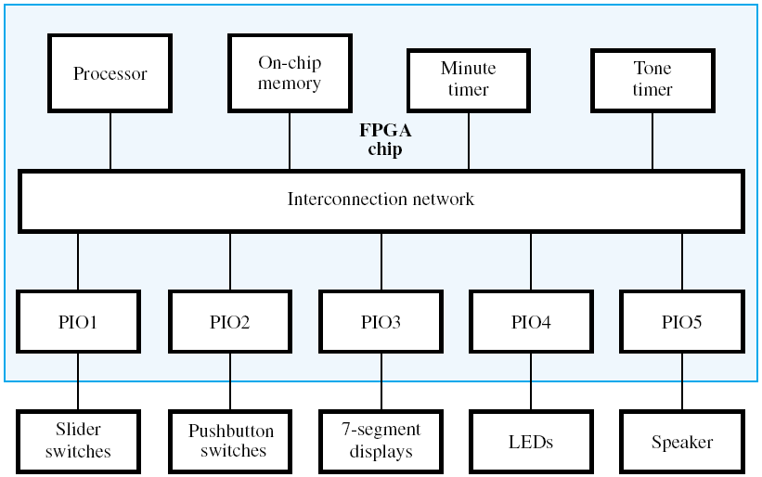
Block diagram of the alarm clock

Slide 13
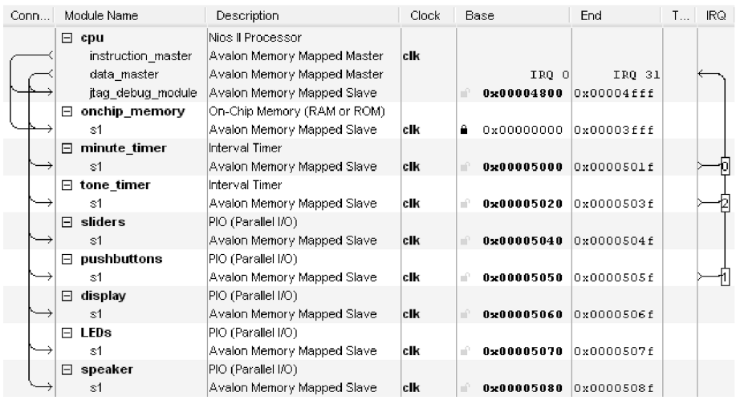
System designed using the SOPC Builder

Slide 14
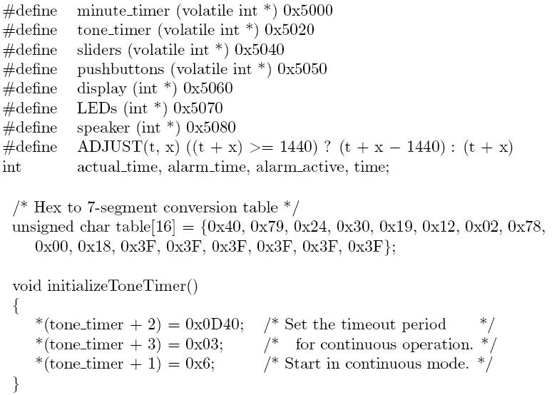
Figure 11.6 – C program for alarm clock
Continued on the next slide

Slide 15
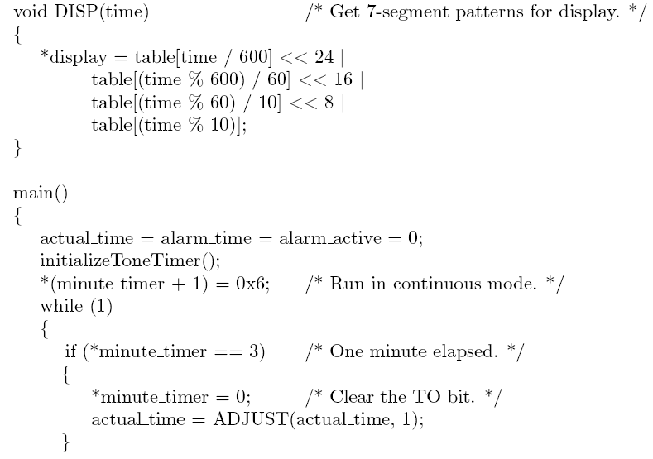
Figure 11.6 (continued)
Continued on the next slide

Slide 16
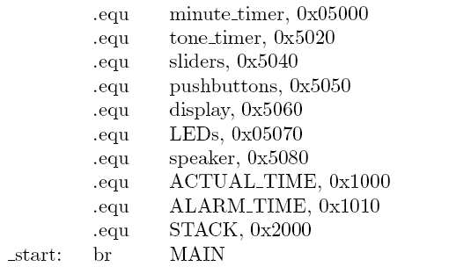
Figure 11.7 – assembly-language version
with interrupt handler for timer
Continued on the next slide

Slide 17
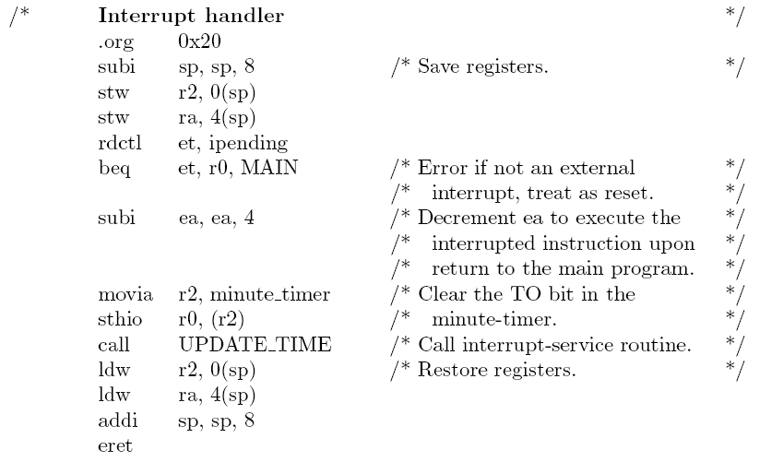
Figure11.7 (continued)
Continued on the next slide

Slide 18
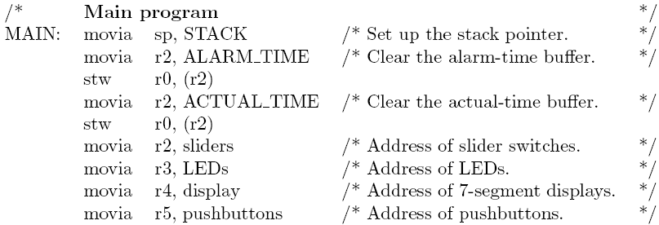
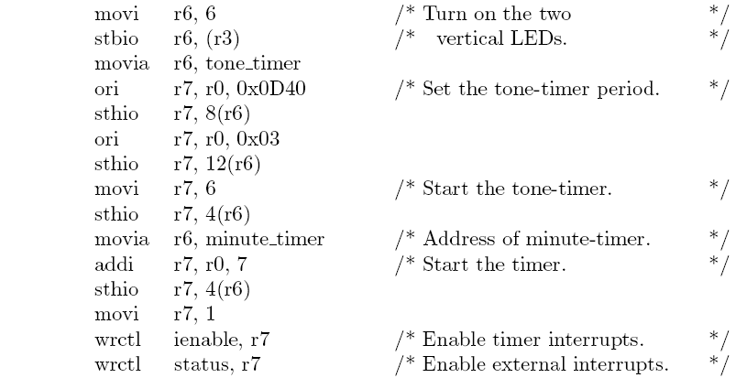

Slide 19
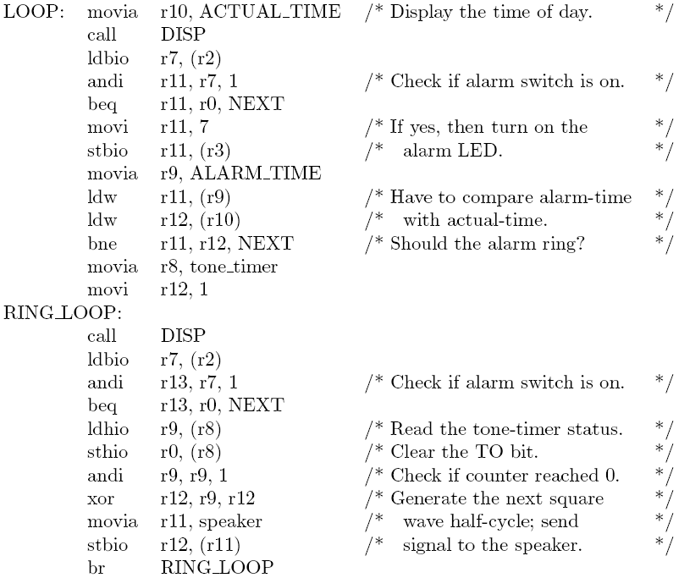

Slide 20
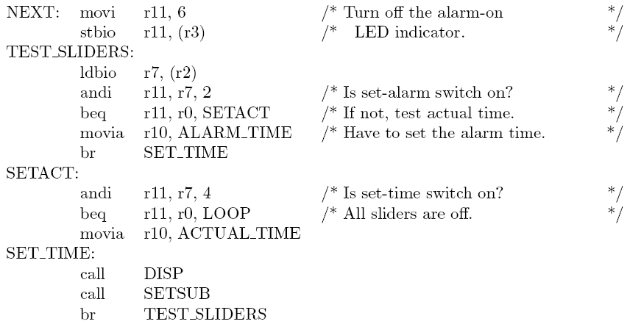
Figure 11.7 (continued)
Continued on the next slide

Slide 21
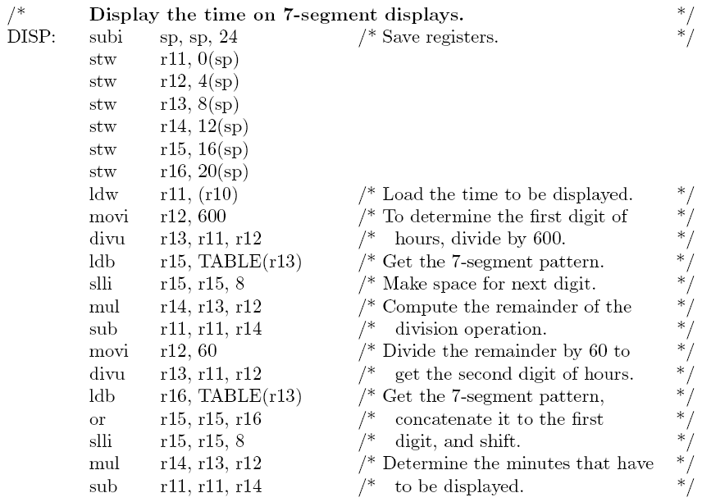
Figure 11.7 (continued)

Slide 22
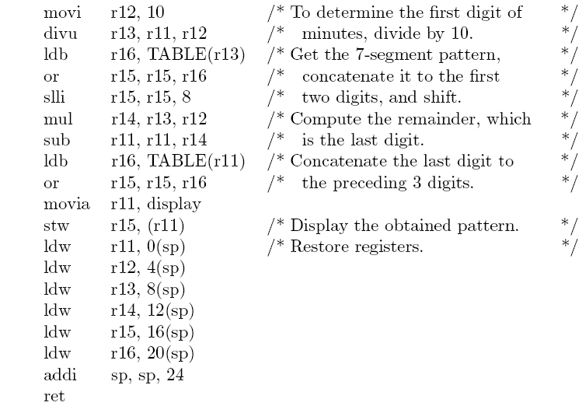
Figure 11.7 (continued)
Continued on the next slide

Slide 23
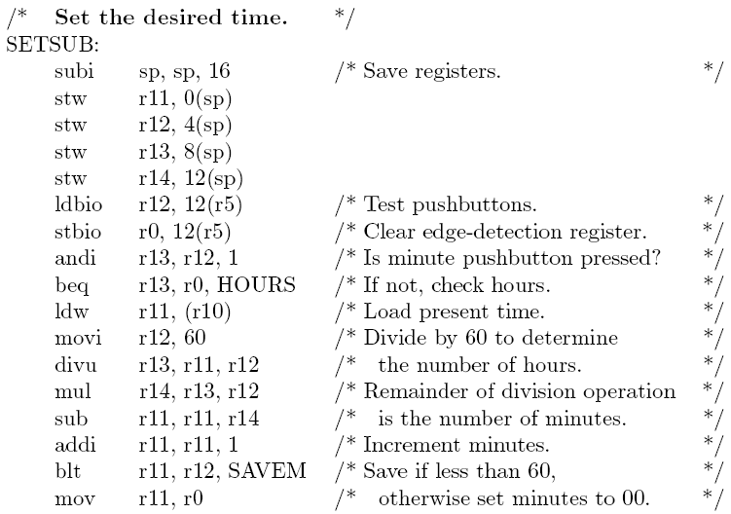
Figure 11.7 (continued)
Continued on the next slide

Slide 24
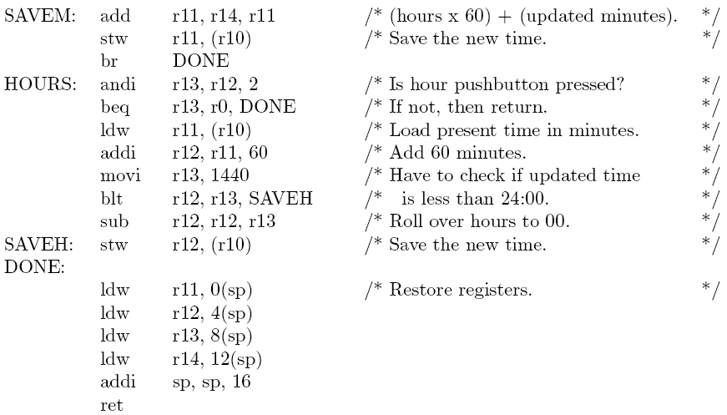
Figure 11.7 (continued)
Continued on the next slide

Slide 25
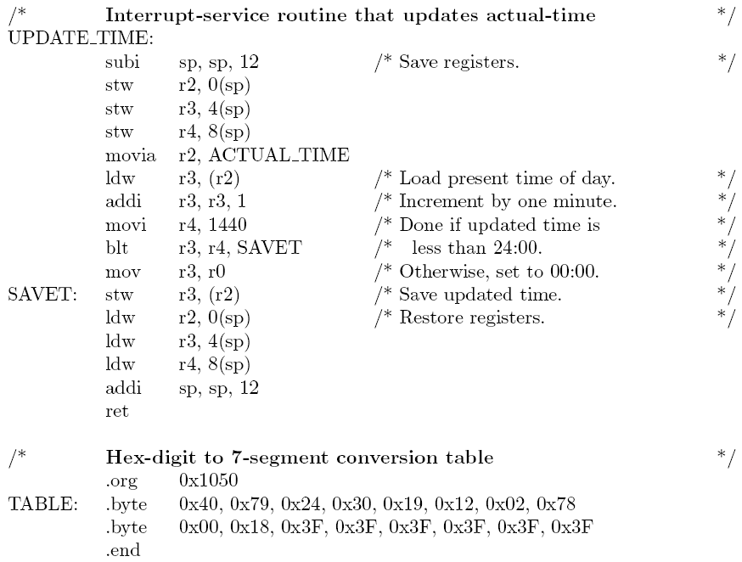
Figure 11.7 (continued)

